Slide 1
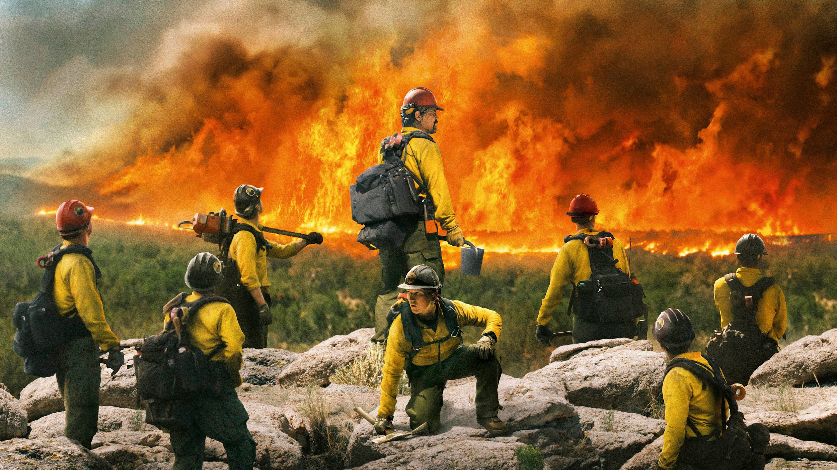
Fire in San Diego
Yucheng Peng

Slide 2
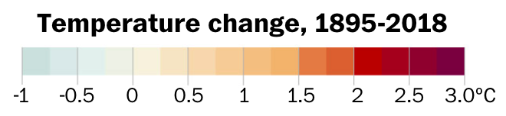


Slide 3
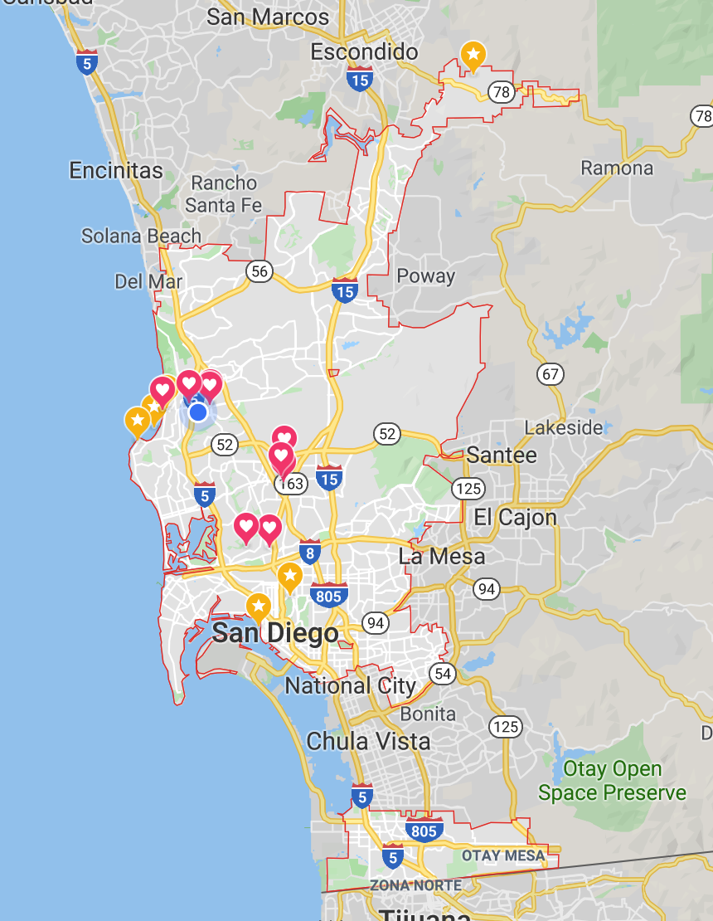



2019 California Fire
Total fires: 6,872 (14.7% of all wildfires of United States)
Total area: 253,321 acres (1.22 * the size of San Diego)
Cost: $163 million

Slide 4
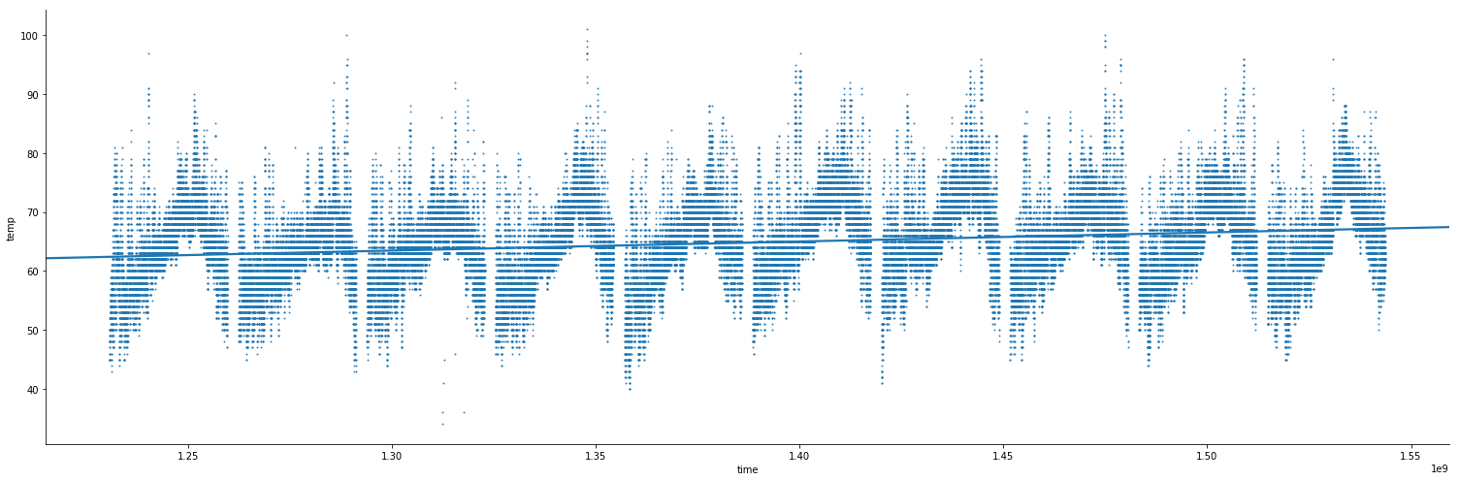
Steady Increase of Temperature over 10 Years
Measured at San Diego International Airport

Slide 5
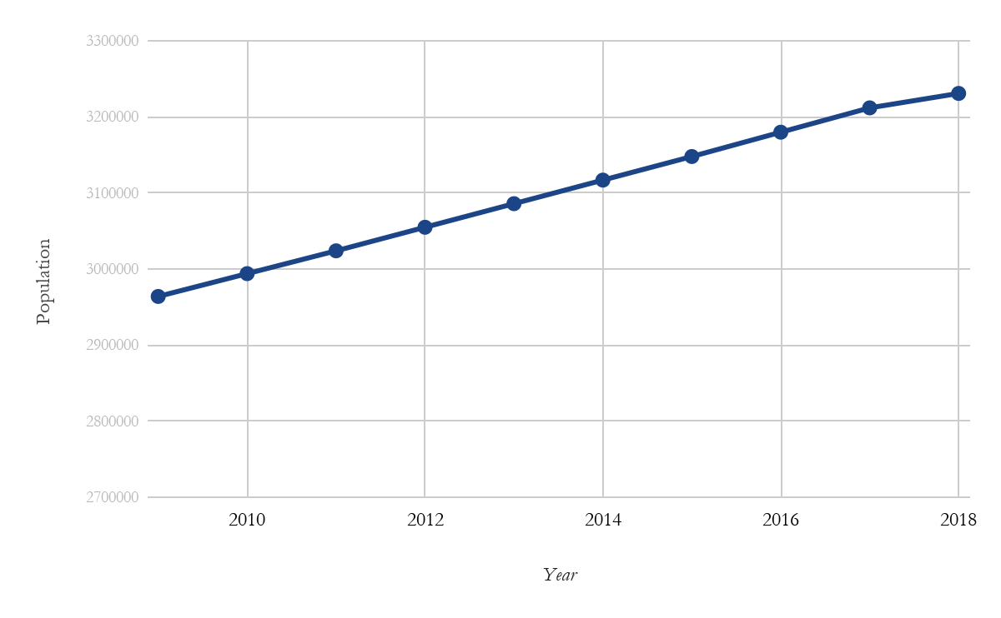
Steady Increase of Population over 10 Years

Slide 6


Major Events That Could Have Led to the Decrease

Slide 7
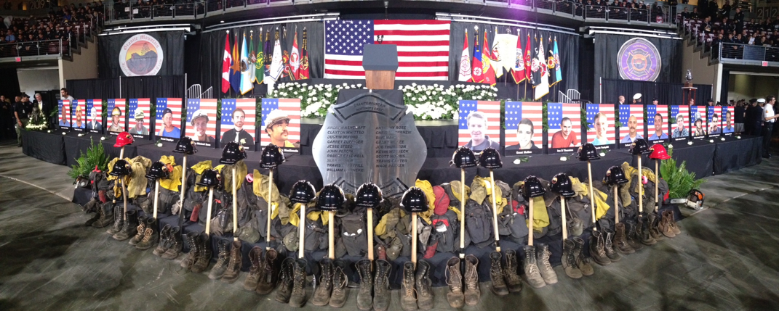
In Memory of the Hotshots and All Fire Fighters

